Slide 1

Locks and semaphores
Igor Syrytsin
23-04-2024

Slide 2
OVERSIGT
FUNDAMENTALS OF CONCURRENCY AND SCHEDULING
CONCURRENCY PROBLEMS AND SYNCHRONIZATION MECHANISMS
LOCKS/MUTEXES AND THEIR APPLICATION
SEMAPHORES AND THEIR TYPES
ANOMIC OPERATIONS AND IMMUTABLE OBJECTS
SUMMARY
IGOR SYRYTSIN, CAOS, SW4 2024

Slide 3
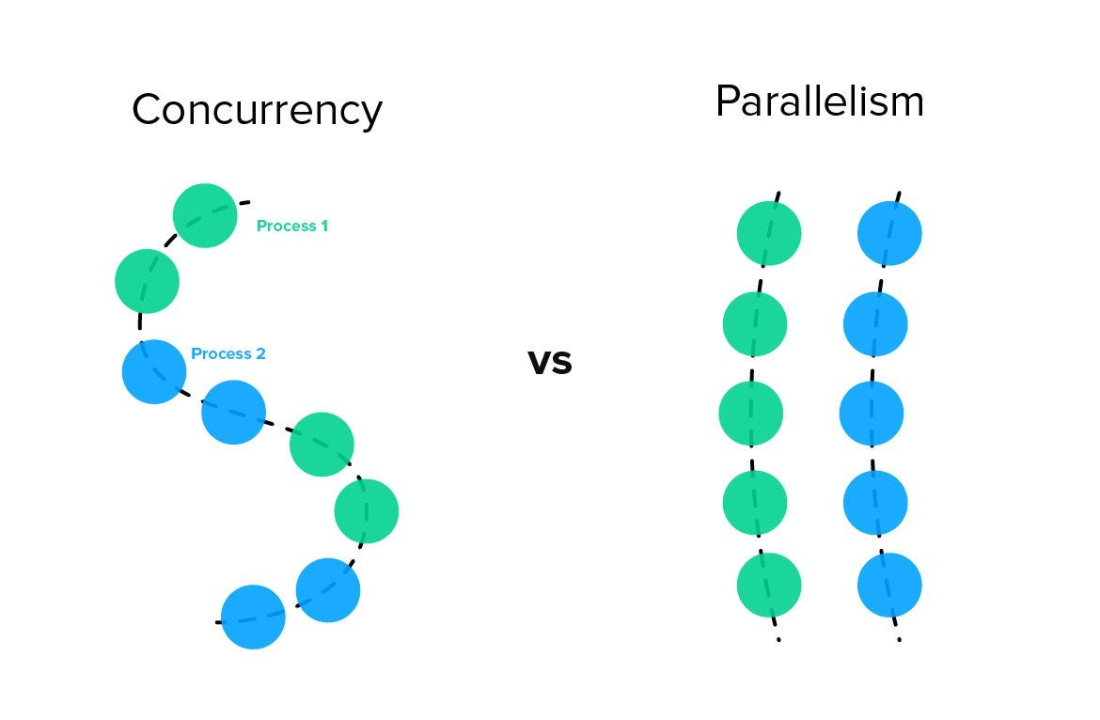
1 - FUNDAMENTALS OF CONCURRENCY AND SCHEDULING
IGOR SYRYTSIN, CAOS, SW4 2024

Slide 4
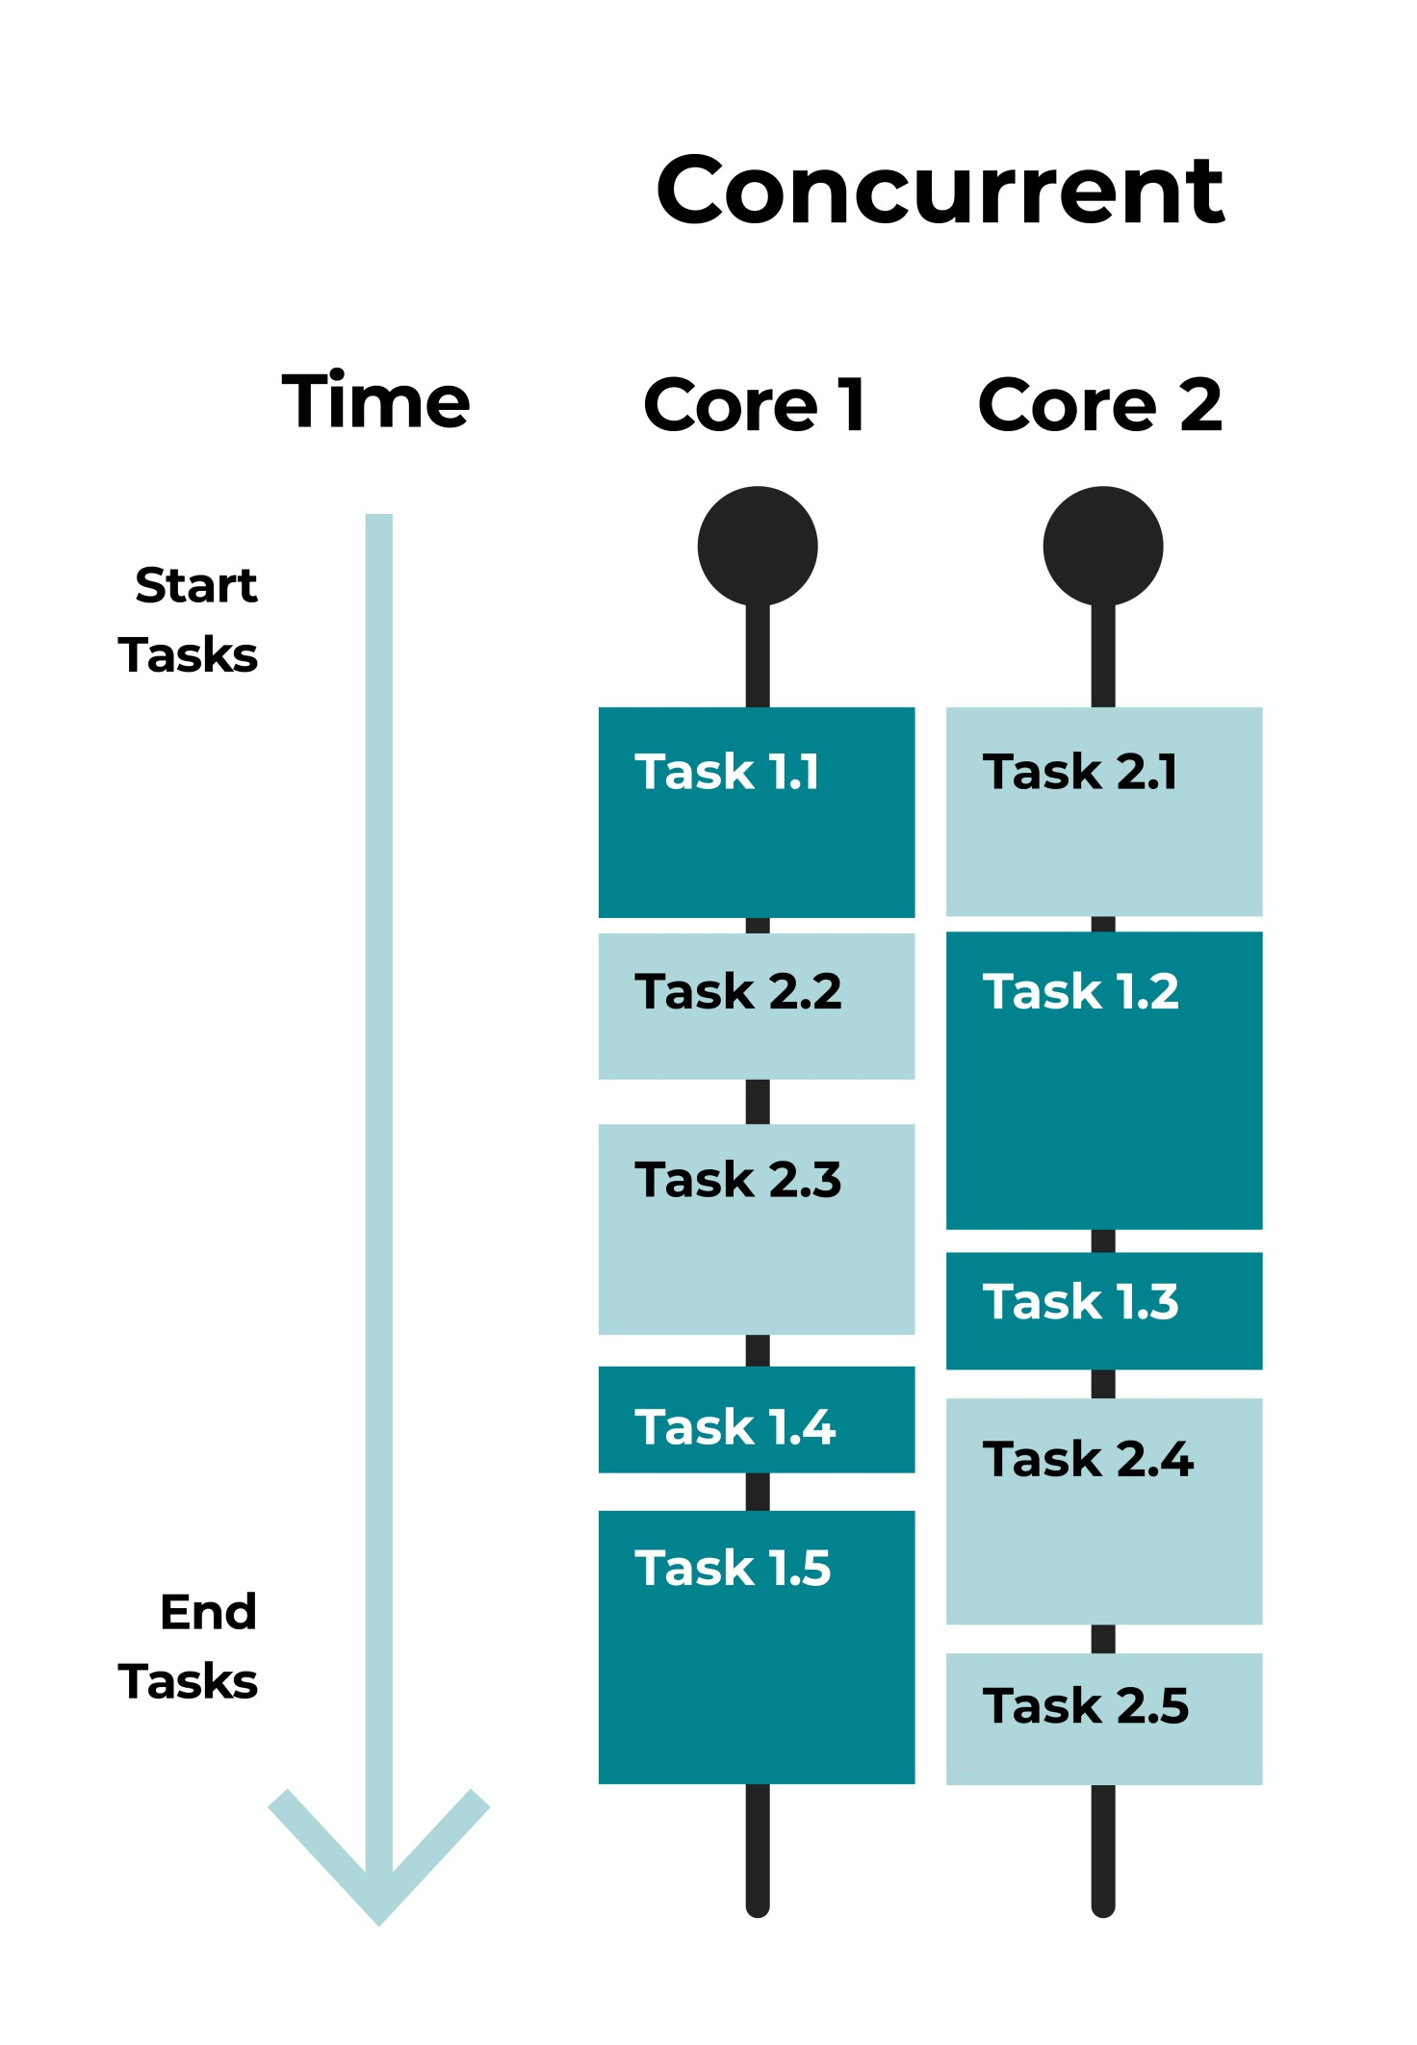
1.1 – CONCURRENCY RECAP
Definition of Concurrency: Multiple tasks are making progress over the same period, with tasks split between cores for simultaneous execution.
Core Utilization: The figure shows tasks divided between Core 1 and Core 2, illustrating how a concurrent system utilizes multiple cores to handle different tasks.
Task Distribution: Tasks are distributed between cores in a way that maximizes efficiency; each core processes its set of tasks (Task 1.1, Task 2.2, etc.) independently.
Concurrent Execution: The tasks start and end in overlapping time frames, indicative of a concurrent processing system, as opposed to sequential execution.
System Throughput: The concurrency increases system throughput by handling more tasks in the same time frame, as seen with the five tasks on each core.
Overlapping Tasks: The graphic depicts overlapping tasks on different cores, suggesting that while one task is being executed on one core, another is being processed on the second core, ensuring continuous operation without idle time.
IGOR SYRYTSIN, CAOS, SW4 2024

Slide 5
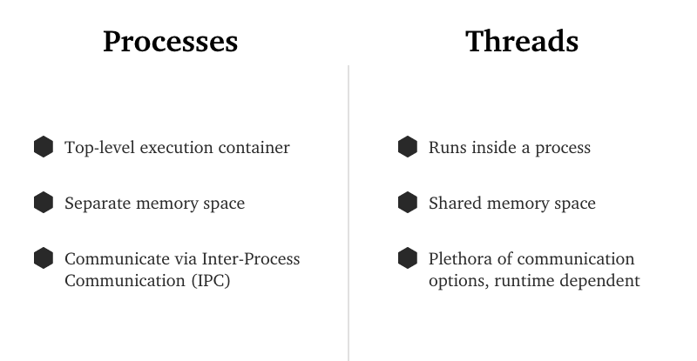
1.2 - PROCESSES VS. THREADS
IGOR SYRYTSIN, CAOS, SW4 2024

Slide 6
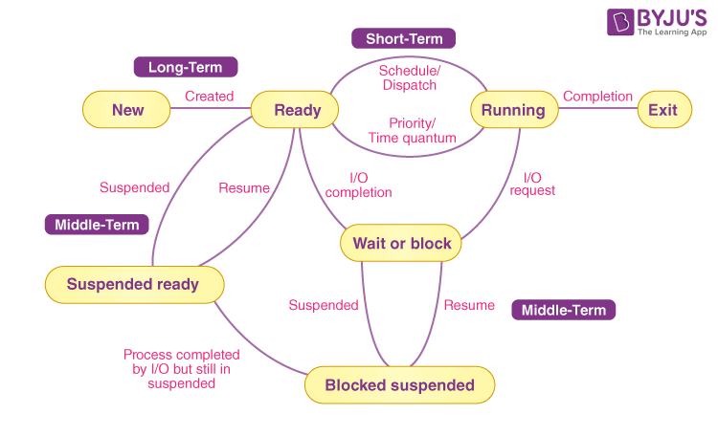
1.3 - BASICS OF PROCESS SCHEDULING
Process States: Processes can be new, ready, running, waiting, or terminated.
Schedulers: Long-term schedulers introduce new processes; short-term schedulers move processes to running state.
Wait/Block: Processes may wait for I/O operations or get suspended to free resources.
Resumption and Exit: Suspended processes resume when possible; completed processes exit, freeing resources.
IGOR SYRYTSIN, CAOS, SW4 2024

Slide 7
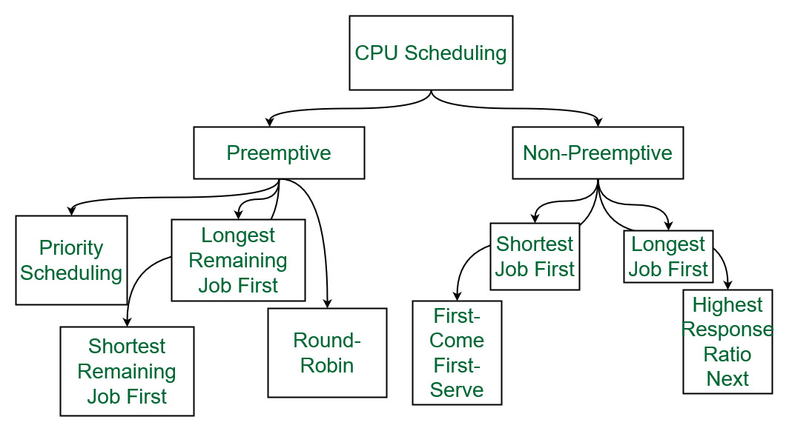
1.4 - SCHEDULING ALGORITHMS
IGOR SYRYTSIN, CAOS, SW4 2024

Slide 8
1.5 -PREEMPTIVE VS NON-PREEMPTIVE SCHEDULING
Preemptive Scheduling: Allows the system to interrupt and switch out processes currently running on the CPU, providing more responsive multitasking.
Non-Preemptive Scheduling: Once a process starts execution on the CPU, it runs until completion or a blocking operation, preventing interruption by other processes and potentially leading to less responsive systems.
Priority and Time Quantum: Preemptive scheduling often considers priority and time slices (quantum), ensuring high-priority processes get CPU time and that no single process monopolizes the CPU.
Use Cases: Non-preemptive is simpler and can be used for batch processing, while preemptive is suited for interactive systems where user responsiveness is crucial.
IGOR SYRYTSIN, CAOS, SW4 2024

Slide 9
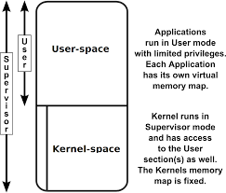
1.6 –USER –LEVEL VS KERNEL LEVEL
User space: This is the memory area where user applications and programs run. It is limited in terms of the system resources it can directly access, in order to prevent applications from interfering with each other or with the operating system itself.
Kernel space: This is the privileged area of memory where the core of the operating system, known as the kernel, resides. The kernel has direct access to the system's hardware and resources, and it manages system operations such as process scheduling, memory management, and device control.
IGOR SYRYTSIN, CAOS, SW4 2024

Slide 10
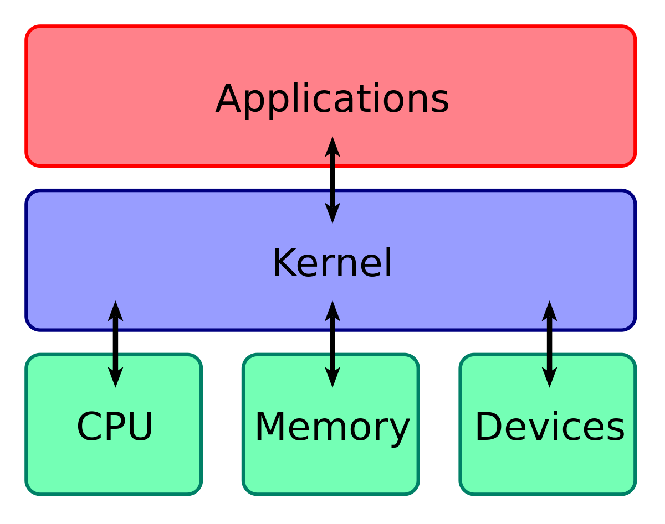
1.7 –KERNEL
Operating System Kernel: The kernel is the core part of the operating system, acting as a mediator between applications and the physical hardware of a computer.
Applications Layer: This top layer consists of user-operated applications which interact with the kernel to perform tasks, utilizing underlying hardware resources.
Hardware Abstraction: The kernel abstracts the complexity of hardware like CPU, memory, and devices, providing a consistent interface for applications to interact with these resources.
Resource Management: The kernel manages resources, allocating CPU time, memory space, and I/O device access efficiently among multiple applications to ensure smooth operation and system stability.
IGOR SYRYTSIN, CAOS, SW4 2024

Slide 11
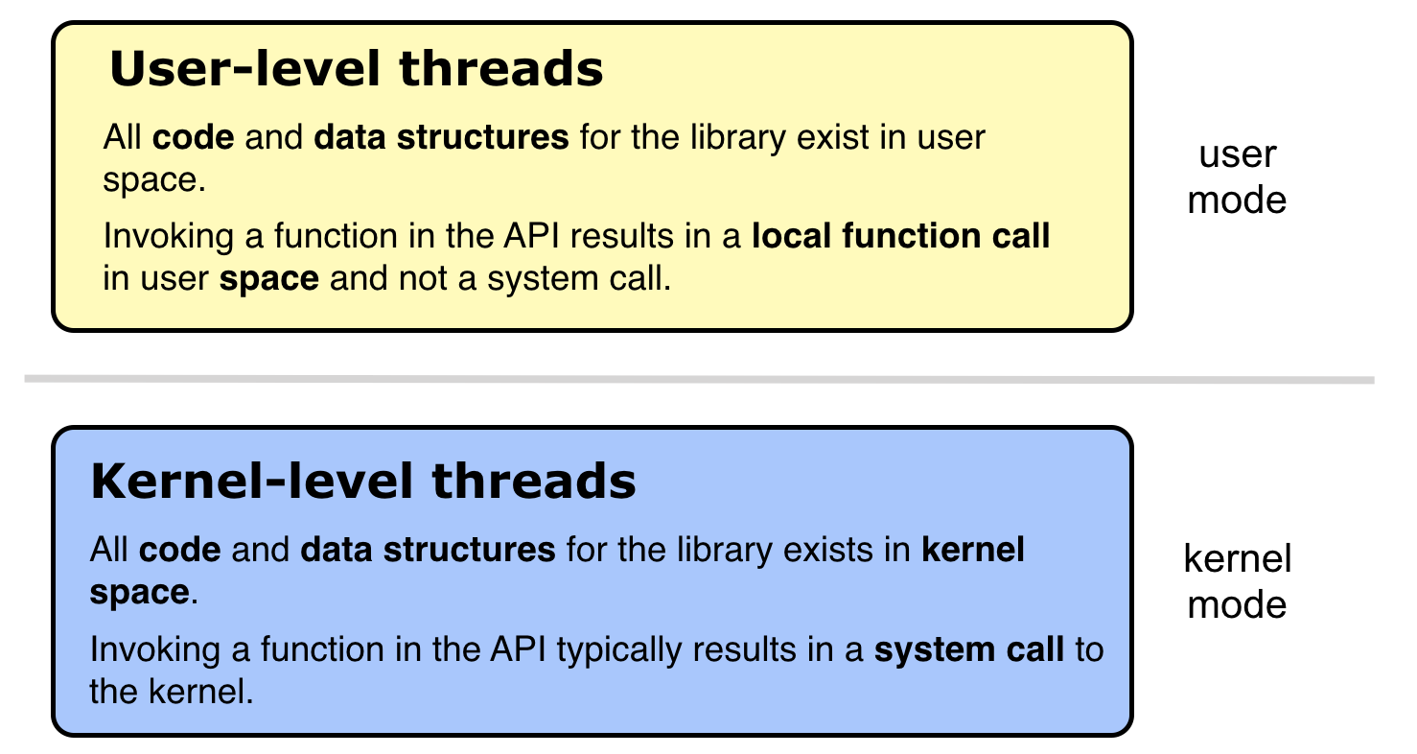
1.8 –User –level vs kernel level
User-level Threads: Operate entirely in user space, meaning their management is done by the thread library at the user level, leading to quick context switches and low overhead.
Kernel-level Threads: Managed directly by the operating system kernel, resulting in a more significant overhead due to system calls, but offering better multi-processor utilization.
Function Calls: In user-level threads, API function calls are local to the process's user space. Conversely, kernel-level threads' API calls involve system calls.
Performance and Control: User-level threads can perform faster within a single process context but lack the kernel's sophistication in handling multi-core processors, whereas kernel-level threads can be slower but have access to advanced scheduling and multi-processing capabilities provided by the OS.
IGOR SYRYTSIN, CAOS, SW4 2024

Slide 12
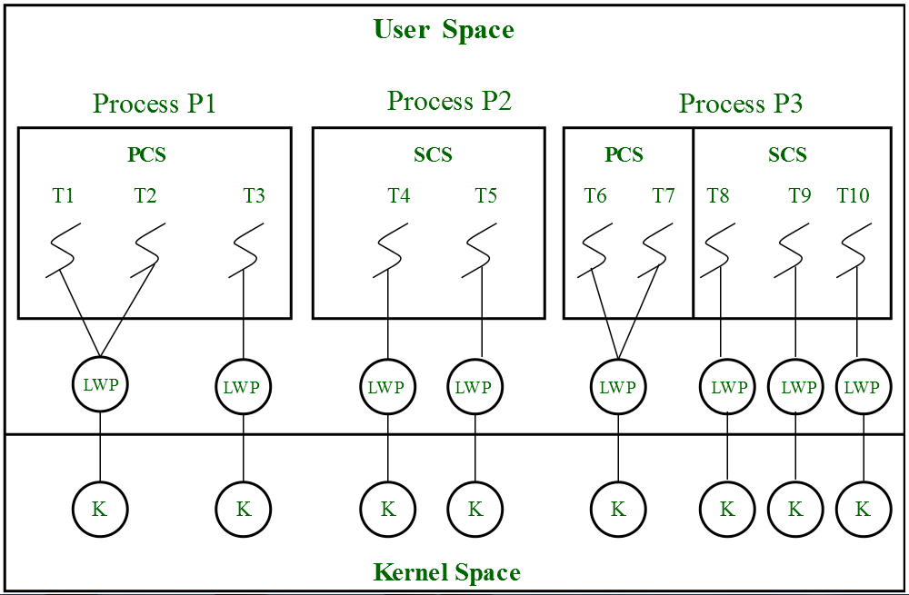
1.9 -THREAD SCHEDULING
Thread-Level Parallelism: The diagram illustrates how multiple threads (T1, T2, etc.) can run in parallel within separate processes (P1, P2, P3), allowing for concurrent execution of tasks.
Lightweight Processes (LWP): Each thread is mapped to a lightweight process, acting as an intermediary between user threads and the kernel, ensuring efficient scheduling and execution by the CPU (represented by 'K').
User and Kernel Space: Threads operate in user space (PCS for private context, SCS for shared context), while the kernel (K) manages their scheduling in kernel space, reflecting the separation of concerns for security and efficiency.
Scheduling Granularity: The scheduler at the kernel level decides which LWPs to execute, affecting the overall throughput and responsiveness of the system, highlighting the importance of the thread scheduler's role.
IGOR SYRYTSIN, CAOS, SW4 2024

Slide 13
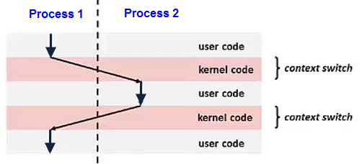
1.10 - CONTEXT SWITCHING
Transition Between Processes: The diagram shows how the system shifts from running user code in Process 1 to user code in Process 2, with kernel code execution in between.
Kernel's Role: When switching context, the kernel saves the state of the current process (Process 1) and loads the saved state of the next process (Process 2).
User-Kernel Transition: The switch from user mode to kernel mode (and back) is necessary during context switching to ensure the system's stability and security.
Switching Overhead: Each context switch involves some overhead, as indicated by the time spent in kernel mode, impacting overall system efficiency.
IGOR SYRYTSIN, CAOS, SW4 2024

Slide 14
1.11 - COST OF CONTEXT SWITCHING
Performance Impact: Context switching can significantly impact system performance due to the time and resources required to switch from one process or thread to another.
CPU Overhead: Every context switch requires the CPU to save the state of the current task and load the state of the next task, using valuable CPU cycles that could be spent on executing tasks.
Cache Warming: After a context switch, the new task's cache is cold, which can lead to an increase in cache misses and subsequently degrade the performance until the cache is warmed up with the new task's data.
Scheduler Efficiency: The efficiency of the scheduling algorithm plays a crucial role in minimizing the cost of context switching by optimizing the order and timing of task execution.
System Throughput: Excessive context switching can reduce overall system throughput as the time spent on non-productive switches adds up, especially in systems with numerous concurrent processes or threads.
IGOR SYRYTSIN, CAOS, SW4 2024

Slide 15
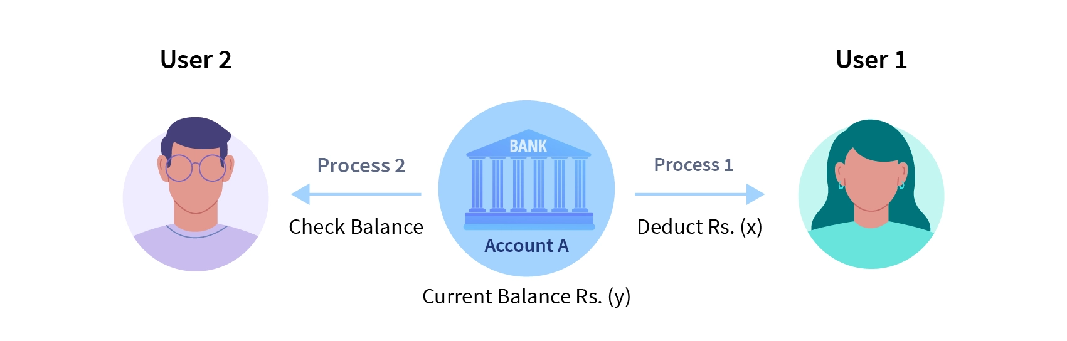
1.12 - CONCURRENCY PROBLEMS AND SYNCHRONIZATION MECHANISMS
User 1's Process (Process 1): This process is executing a transaction that deducts a certain amount (Rs. x) from an account (Account A). If this process reads the current balance and performs the deduction without any synchronization mechanism in place, there's a risk that another process may access the balance concurrently, leading to inaccurate results.
User 2's Process (Process 2): Concurrently, this process is checking the balance of the same account. If Process 2 reads the balance while Process 1 is midway through its deduction but before it writes back the new balance, User 2 will see an outdated balance, leading to a race condition.
Current Balance (Rs. y): This is the balance amount that both processes are trying to read and modify. The race condition arises if the read, modify, and write operations are not atomic.
IGOR SYRYTSIN, CAOS, SW4 2024

Slide 16
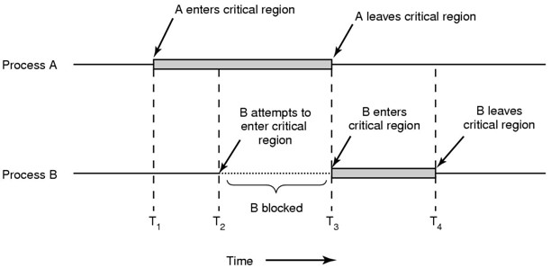
1.13 - CRITICAL SECTION AND MUTUAL EXCLUSION
Two processes, A and B, compete for access to a shared resource.
At time T1, process A enters the critical region.
Process B is blocked at time T2 because A is already using the resource.
Process B gains access to the critical region after A exits at time T3.
Time T4 indicates when B leaves the critical region.
Mutual exclusion ensures that only one process can access the critical region at a time.
IGOR SYRYTSIN, CAOS, SW4 2024

Slide 17
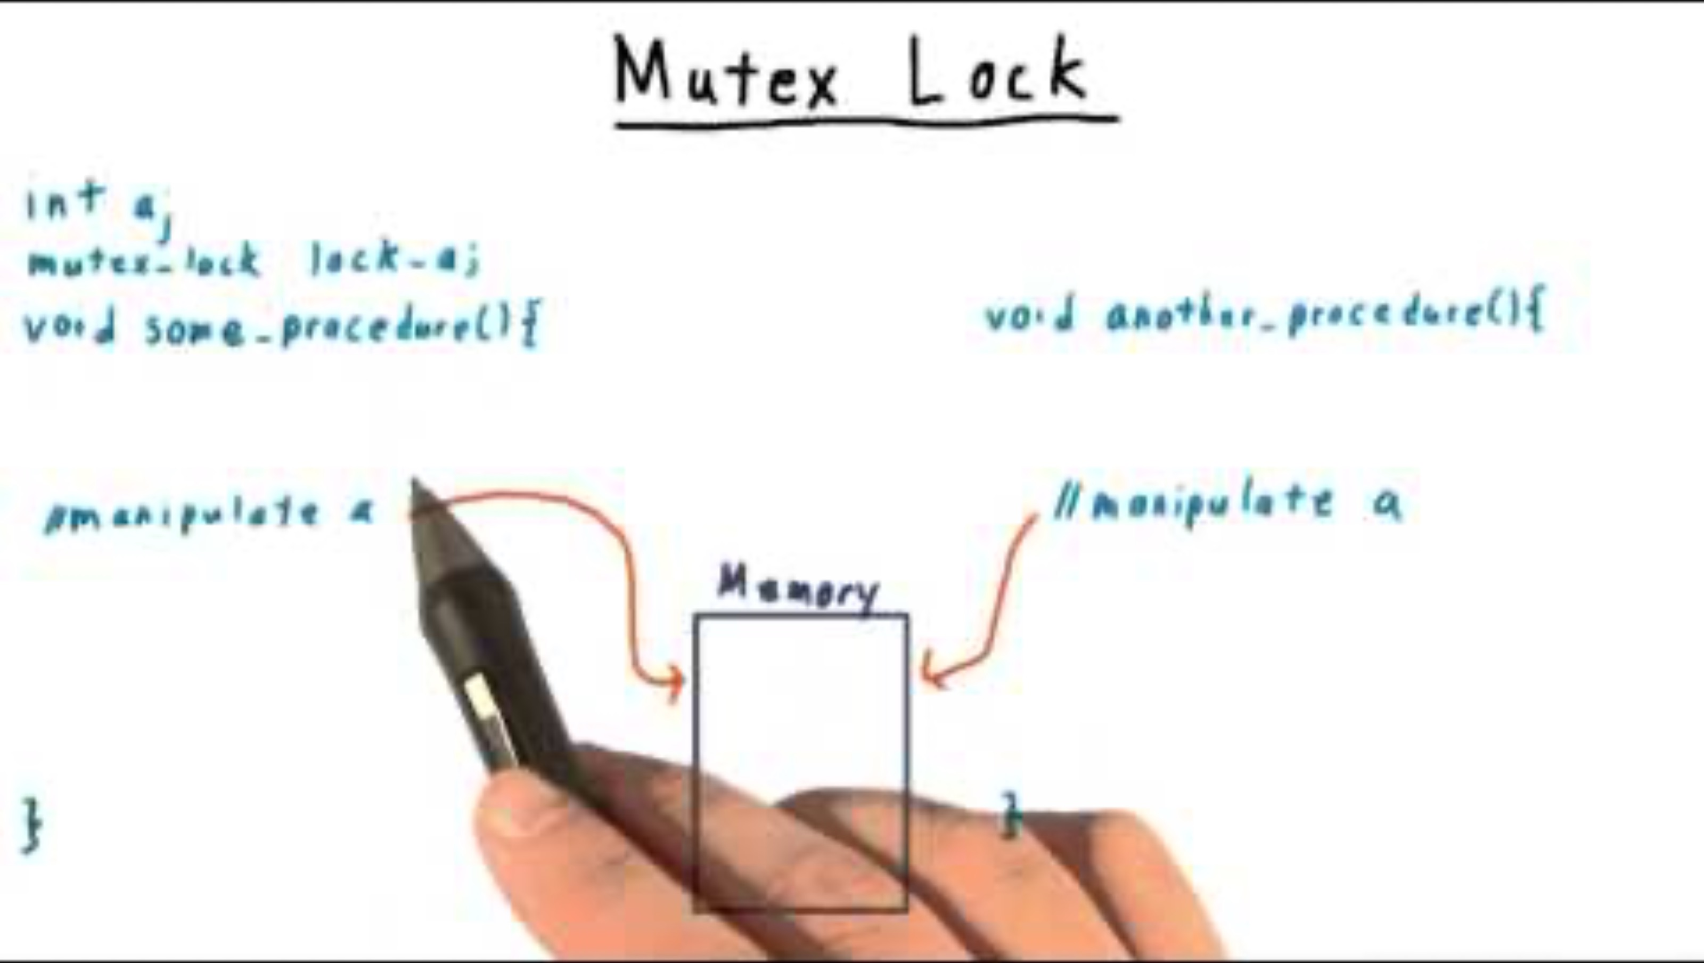
2 - LOCKS/MUTEXES AND THEIR APPLICATION
IGOR SYRYTSIN, CAOS, SW4 2024

Slide 18
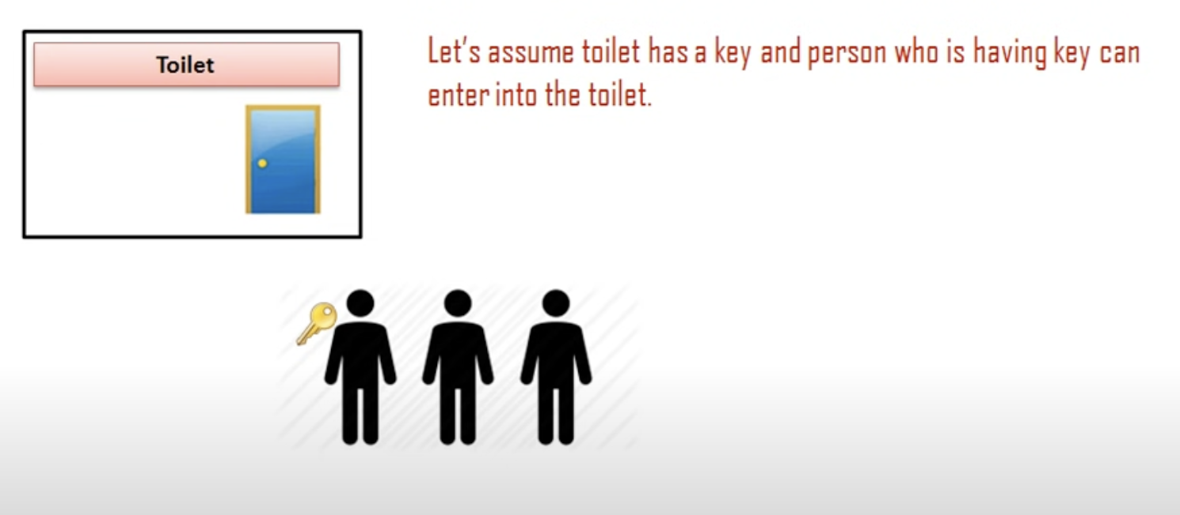
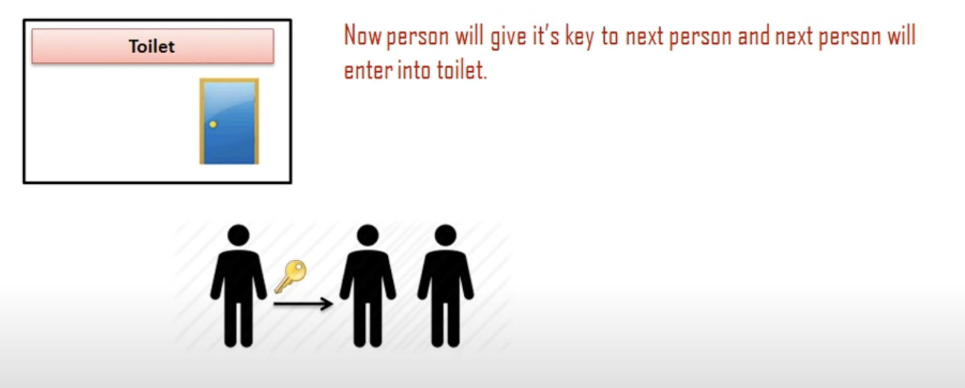
2.1 - LOCKS/MUTEXES
IGOR SYRYTSIN, CAOS, SW4 2024

Slide 19
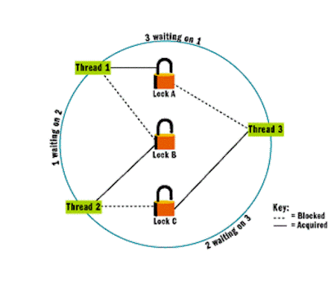
2.2 - Reentrant Locks
Reentrant Locks Explained: Also known as recursive locks, allow the same thread to acquire the same lock multiple times without causing a deadlock.
Deadlock Scenario: Occurs when multiple threads are waiting for locks held by each other, creating a cycle of dependencies with no resolution.
The Role of Reentrant Locks: They help prevent deadlocks by allowing a single thread to pass through critical sections that it has already locked.
Identifying Deadlock Patterns: The "wait-for" graph (as shown in the image) can identify potential deadlocks, with each node representing a thread and edges representing lock acquisition and waiting states.
Handling Deadlocks: Strategies include deadlock avoidance algorithms, deadlock detection and recovery mechanisms, and using reentrant locks where appropriate.
(Thread 1, Thread 2, and Thread 3), each having acquired a lock (Lock A, Lock B, and Lock C respectively) and each waiting for a lock held by another, forming a circular wait condition indicative of a deadlock.
IGOR SYRYTSIN, CAOS, SW4 2024

Slide 20
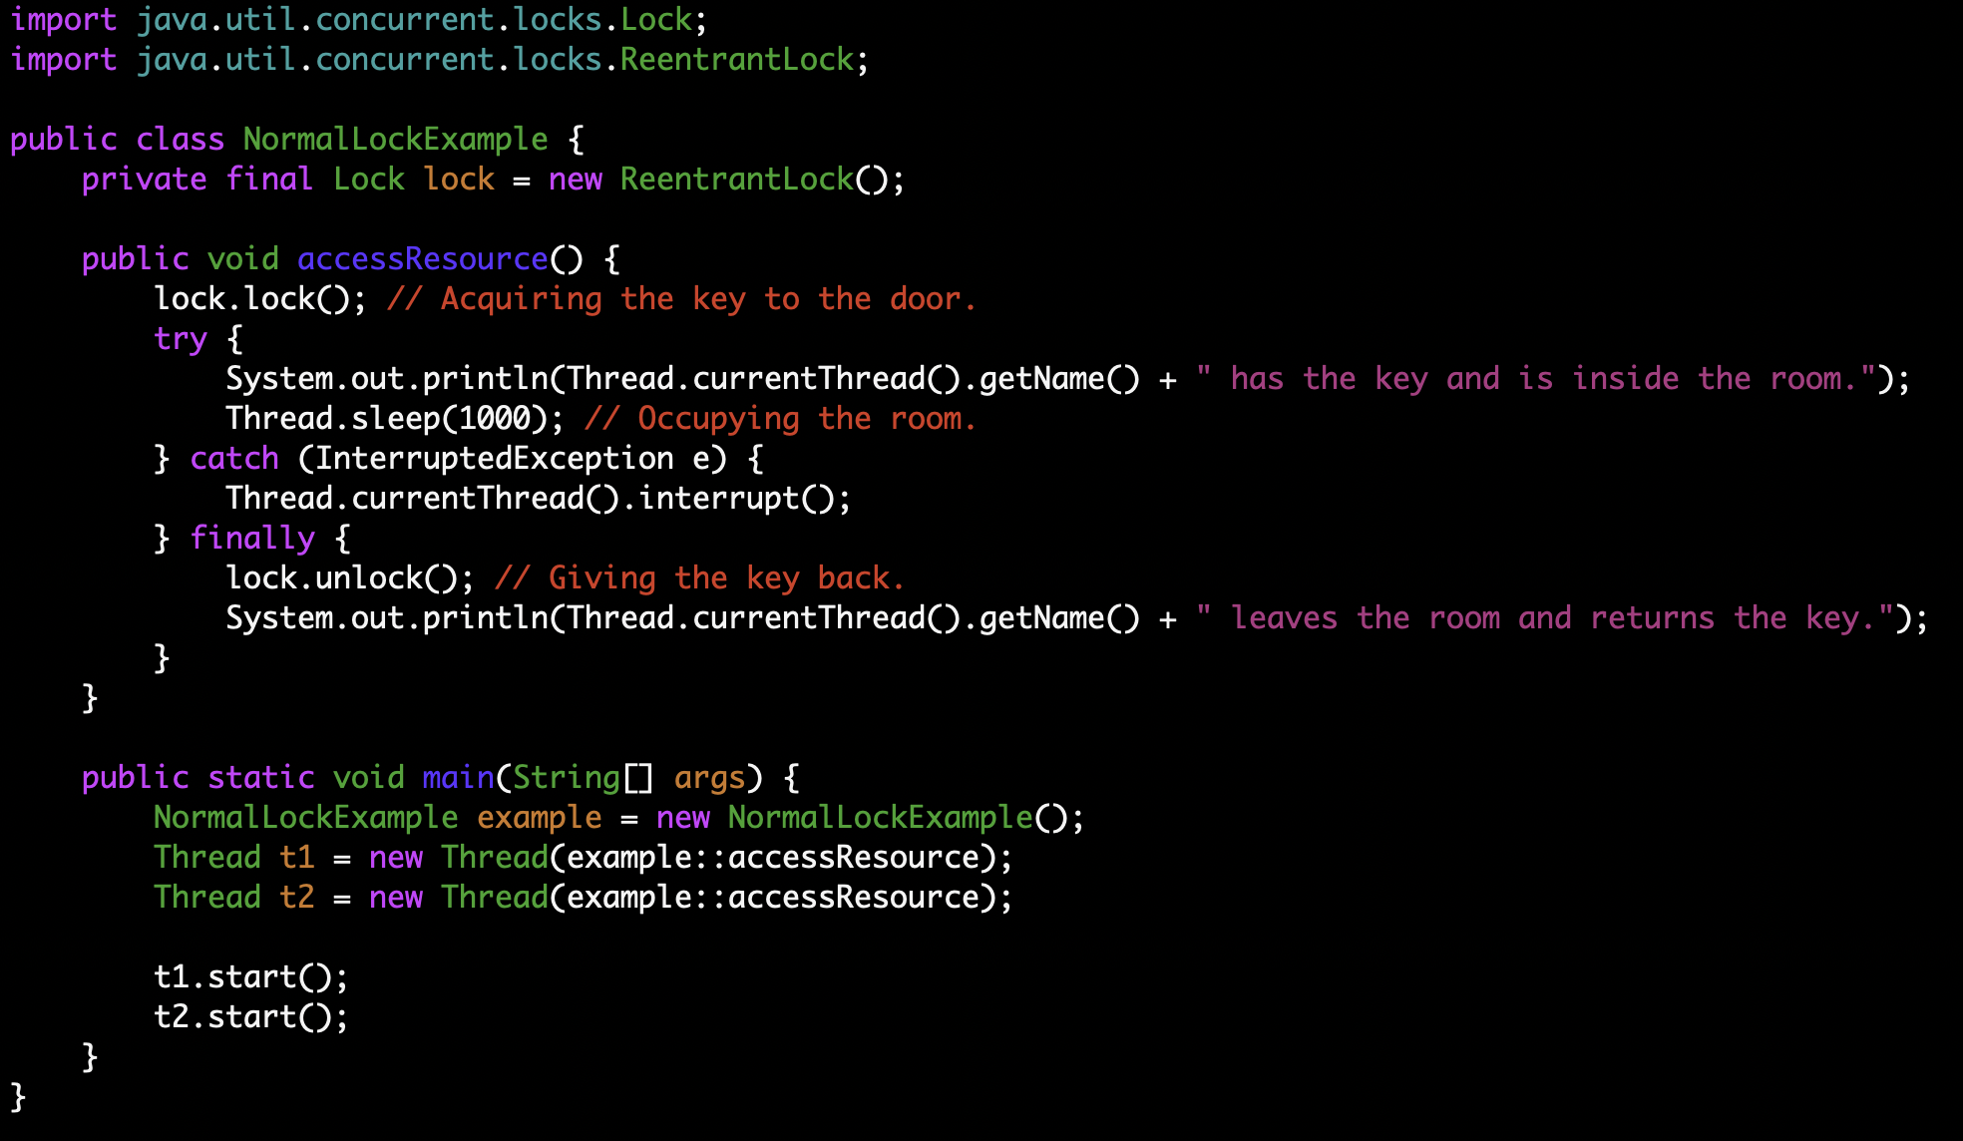
2.3 – LOCKS IN JAVA
IGOR SYRYTSIN, CAOS, SW4 2024

Slide 21
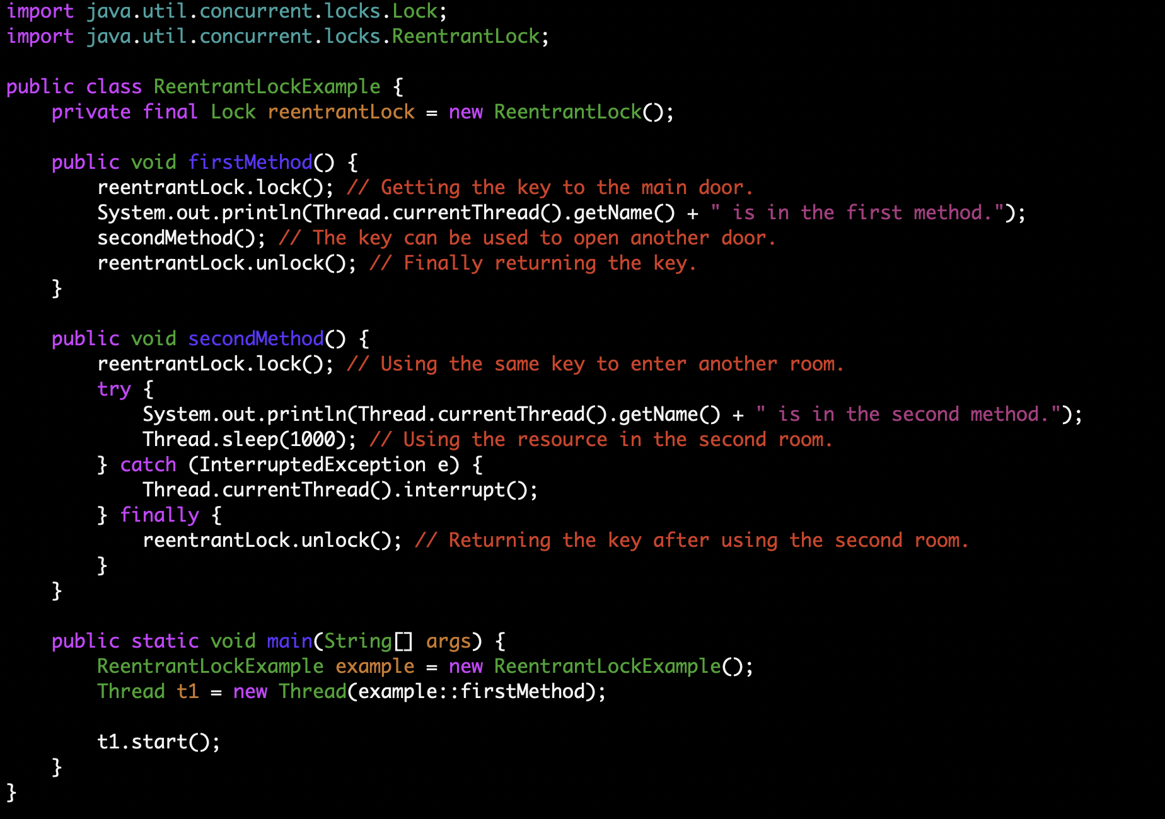
2.4 - REENTRANT LOCKS IN JAVA
IGOR SYRYTSIN, CAOS, SW4 2024

Slide 22
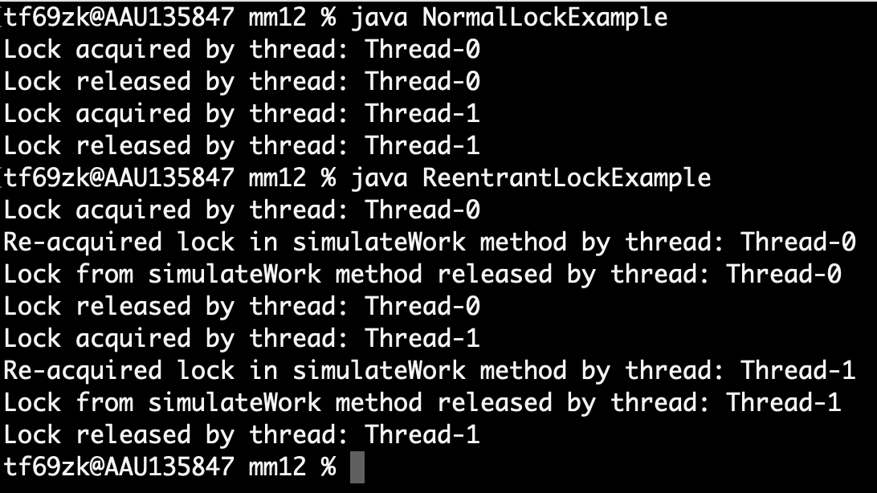
2.5 – LOCKS IN JAVA
Behavior in the First Program (Normal Lock Example):
The lock() and unlock() methods are used to ensure that only one thread at a time can access the critical section.
If t1 acquires the lock first, t2 must wait until t1 completes its work and releases the lock before t2 can acquire it and enter the critical section.
Behavior in the Second Program (Reentrant Lock Example):
The ReentrantLock class allows the thread that holds the lock to re-acquire it without blocking.
In the simulateWork method, the same thread that holds the lock re-acquires it, which is permitted with a reentrant lock.
Both t1 and t2 can re-acquire the lock multiple times as long as they release it the same number of times.
Differences:
Normal locks (as demonstrated by the use of the ReentrantLock in the first program) prevent the thread from acquiring the lock again if it already holds it. In contrast, reentrant locks allow it.
Reentrant locks are useful when a synchronized method calls another synchronized method, both requiring the same lock. With a normal lock, this would lead to a deadlock.
IGOR SYRYTSIN, CAOS, SW4 2024

Slide 23
2.6 - ADVANTAGES OF REENTRANT LOCKS
Avoids Deadlocks: In recursive calls where the same thread needs to acquire the lock multiple times.
Flexible Locking: Allows the thread to step through a series of method calls requiring the same lock without blocking itself.
Try Locking: Provides methods like tryLozck() that attempt to acquire the lock without waiting infinitely, adding more control over lock handling.
Interruptible Locking: Allows threads to be interrupted while waiting for a lock, which can be useful to prevent deadlocks or long waits.
Fairness: Allows a fair lock implementation where the longest-waiting thread gets the lock next, which prevents thread starvation.
IGOR SYRYTSIN, CAOS, SW4 2024

Slide 24
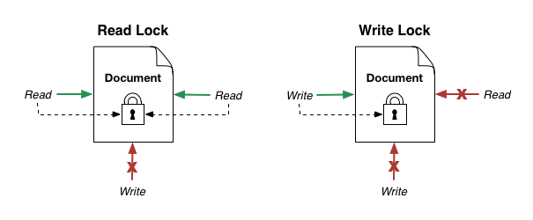
2.7 - READ-WRITE LOCKS
IGOR SYRYTSIN, CAOS, SW4 2024

Slide 25
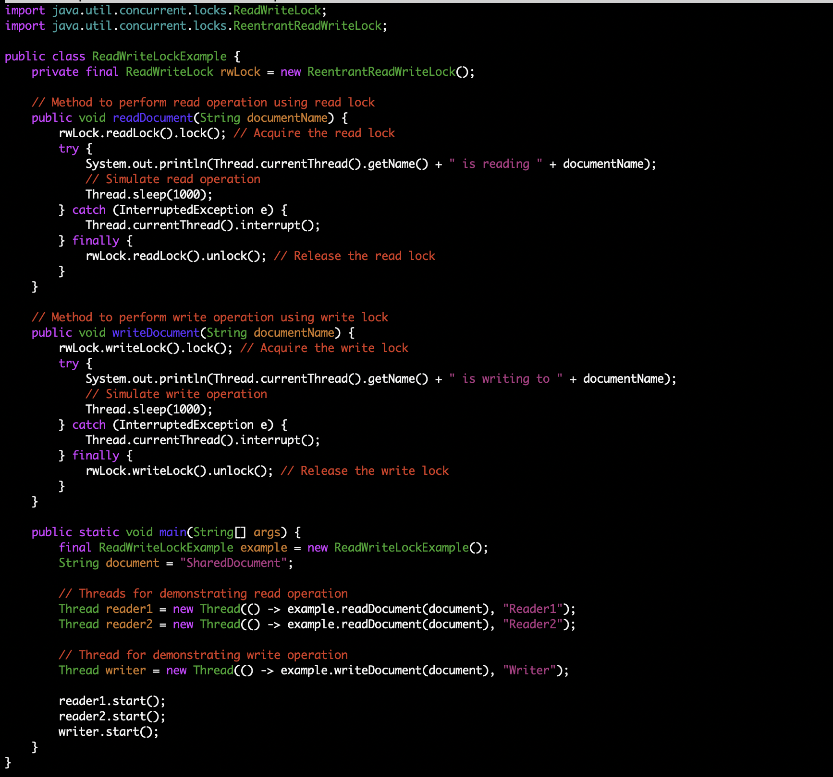
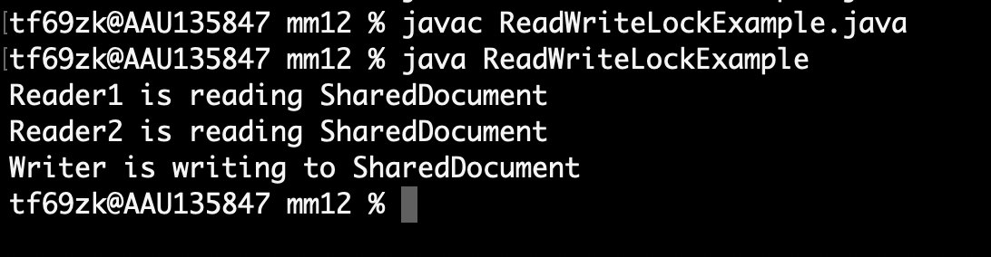
2.8 - READ-WRITE LOCKS
IGOR SYRYTSIN, CAOS, SW4 2024

Slide 26

3 - SEMAPHORES AND THEIR TYPES
Semaphore Types
There are two types of Semaphores –
Binary Semaphore – Only True/False or 0/1 values
Counting Semaphore – Non-negative value
Semaphore Implementation
Semaphore can have two different operations which are wait and signal. In some books wait signals are also denoted by P(s) and signal by V(s). Where s is a common semaphore.
Wait p(s) or wait(s)
Wait decrements the value of semaphore by 1
Signal v(s) or signal(s)
Signal increments the value of semaphore by 1
Semaphore
Semaphore can only have non-negative values
Before the start of the program, it is always initialised to
n in Counting semaphore (Where n is the number of processes allowed to enter critical section simultaneously)
1 in the case of a binary semaphore
IGOR SYRYTSIN, CAOS, SW4 2024

Slide 27
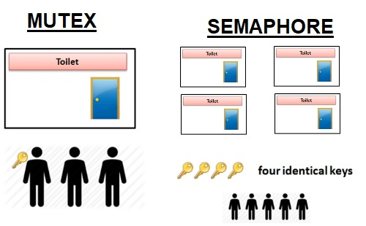
3.1 - Semaphores and their types
IGOR SYRYTSIN, CAOS, SW4 2024

Slide 28
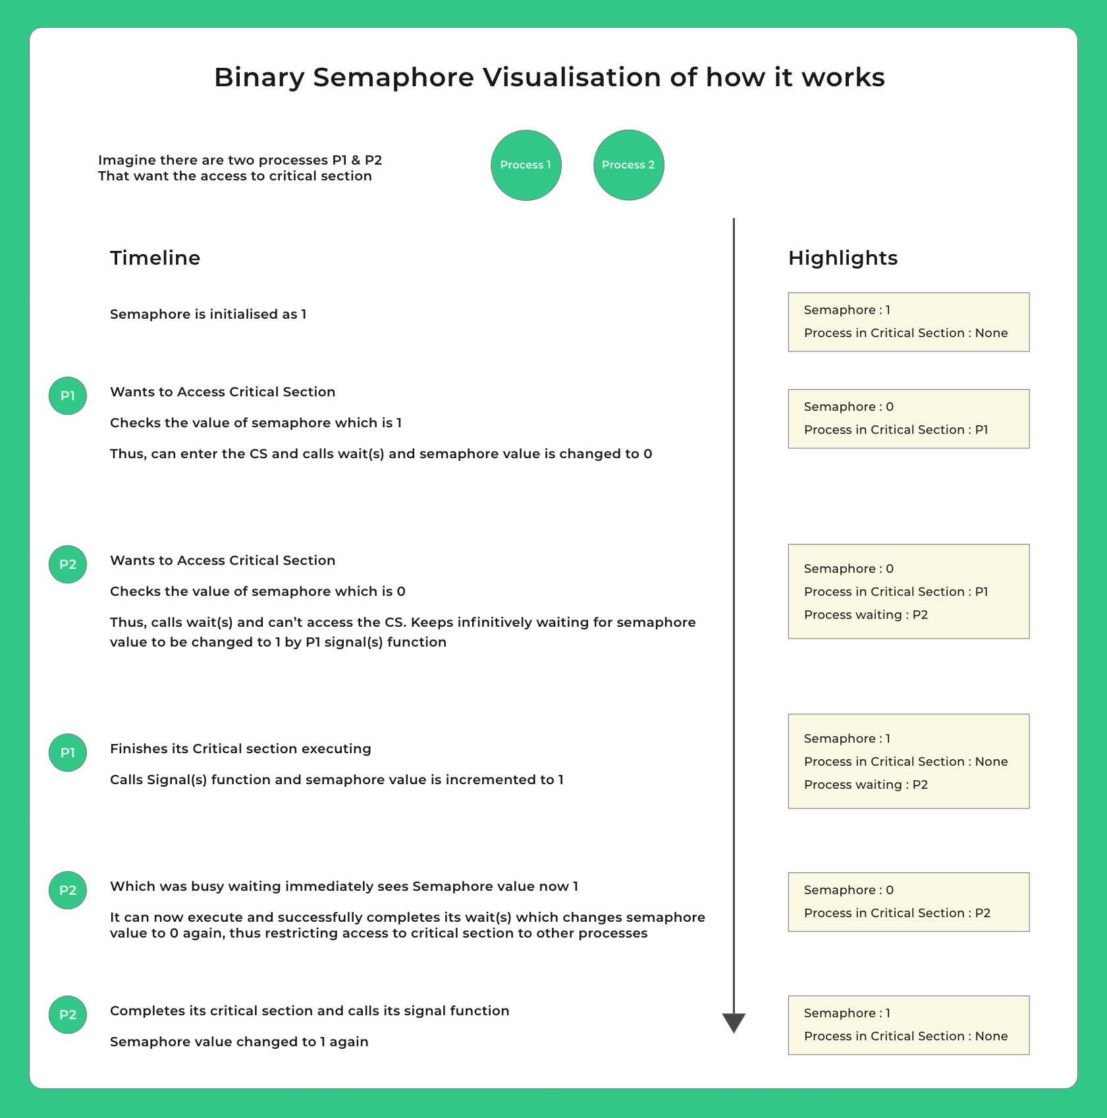
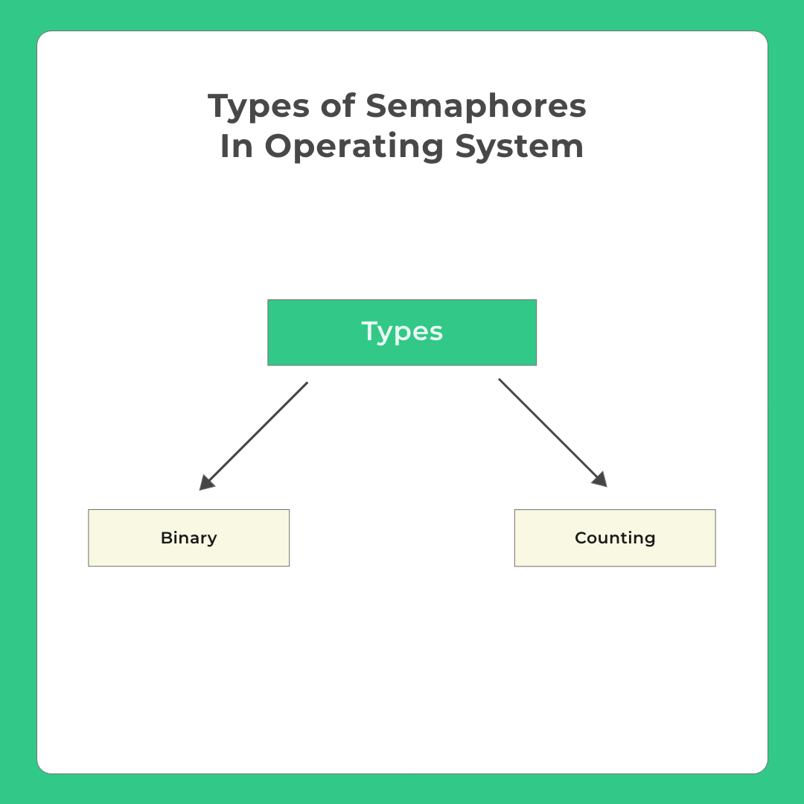
3.2 - SEMAPHORES AND THEIR TYPES
IGOR SYRYTSIN, CAOS, SW4 2024

Slide 29
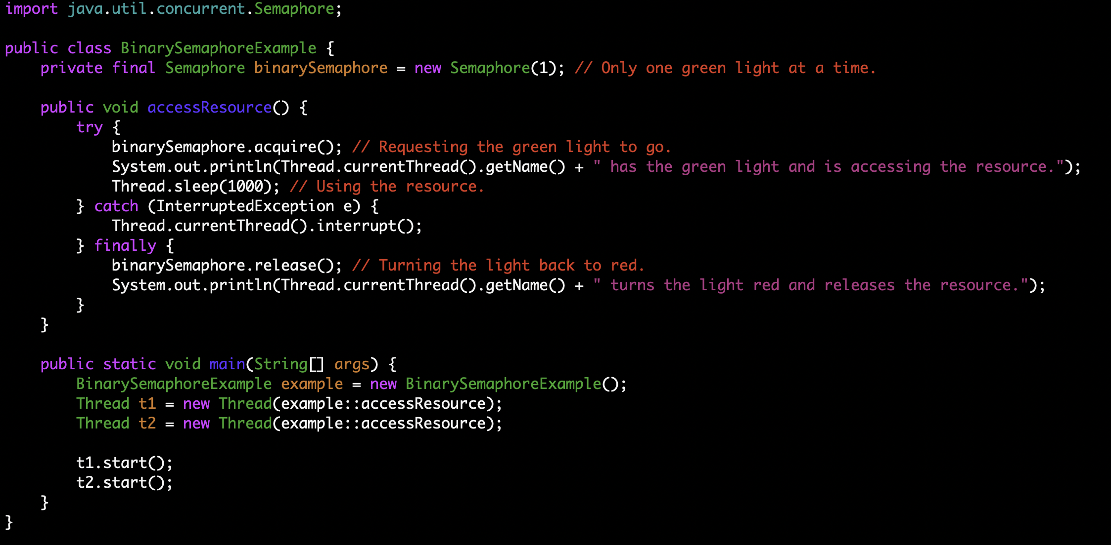
3.3 - SEMAPHORES AND THEIR TYPES
IGOR SYRYTSIN, CAOS, SW4 2024

Slide 30
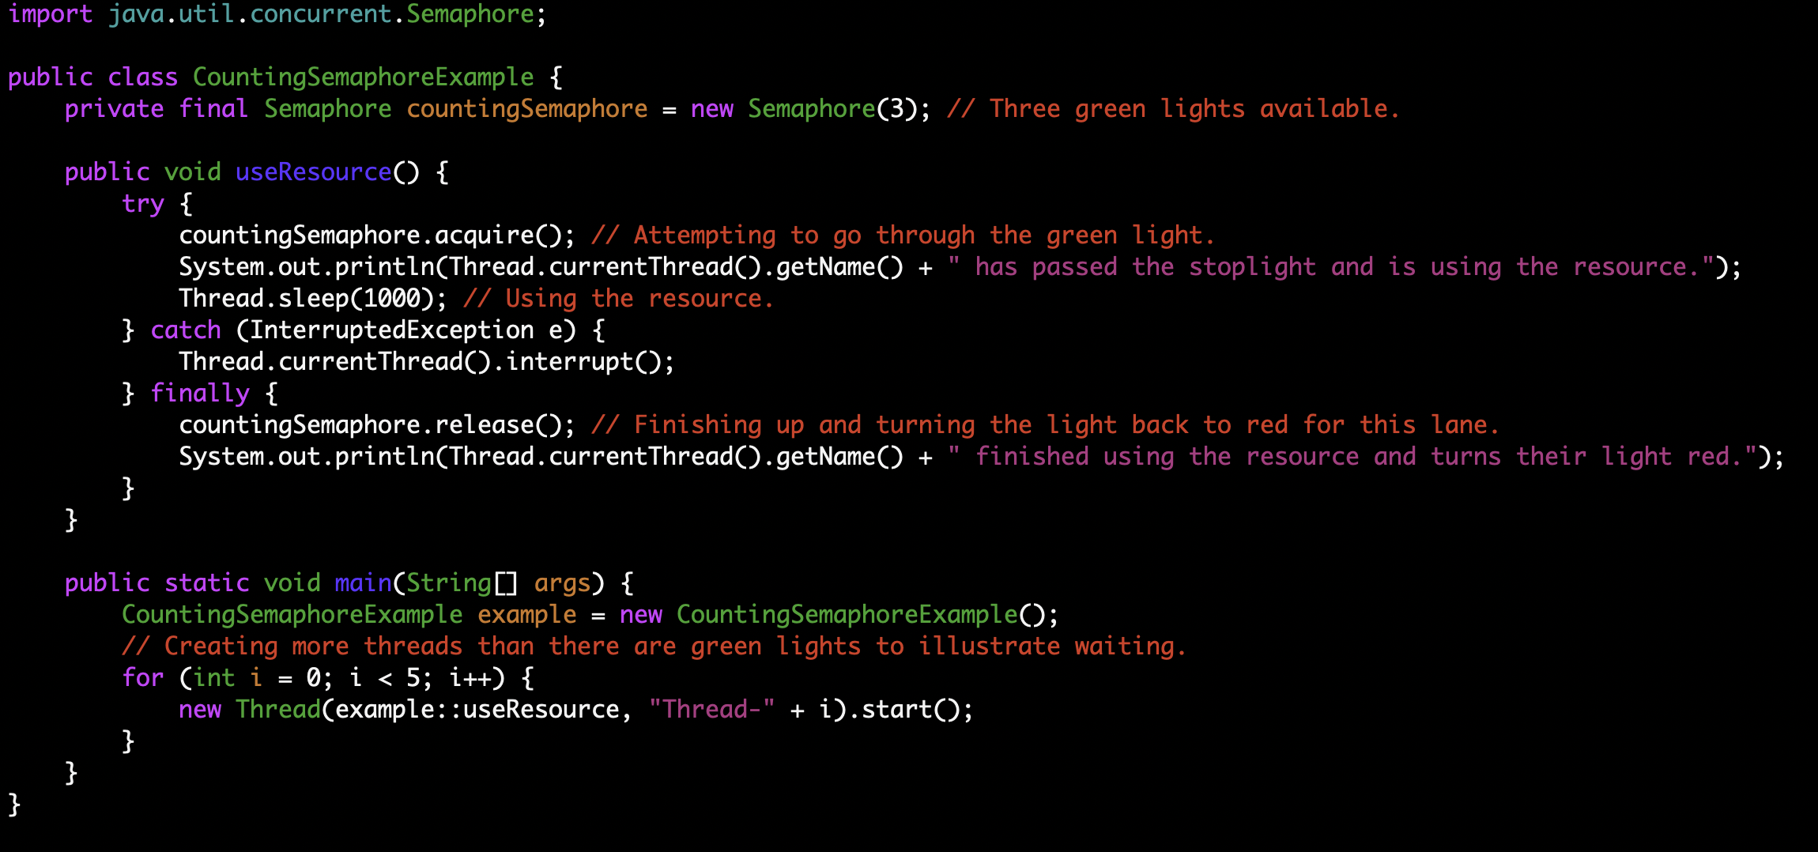
3.4 - SEMAPHORES AND THEIR TYPES
IGOR SYRYTSIN, CAOS, SW4 2024

Slide 31
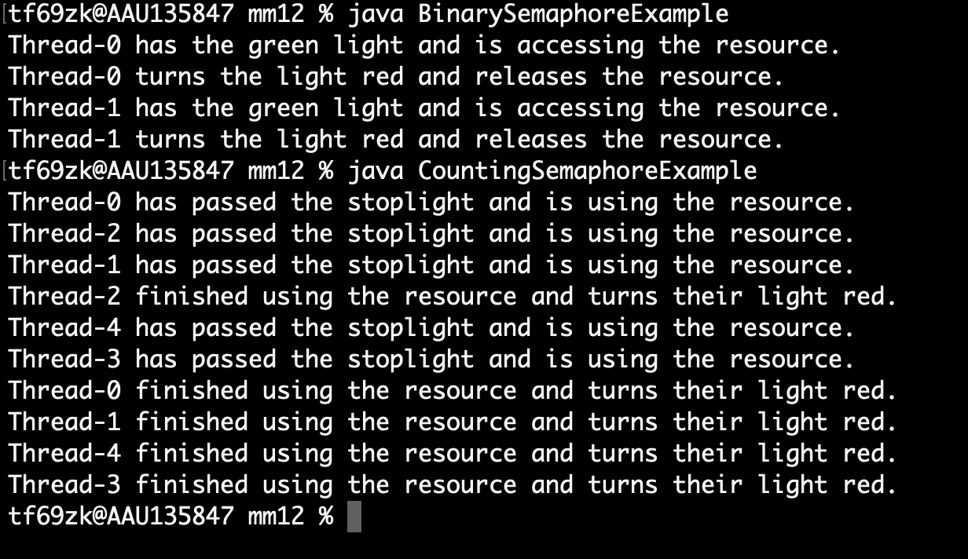
3.5 - SEMAPHORES AND THEIR TYPES
The semaphore acts like a stoplight controlling access to a single-lane bridge. Only one car (thread) can cross at a time. When a car is on the bridge, the light is green for that car and red for all others.
In the counting semaphore example, the semaphore acts like a stoplight for multiple parallel lanes. If the light is green in a lane, a car (thread) can proceed. Once all green lights are taken, other cars must wait until one becomes available. Here, 3 represents the number of lanes, and thus, the number of cars that can go simultaneously.
IGOR SYRYTSIN, CAOS, SW4 2024

Slide 32
3.6 – LOCKS/MUTEXES AND SEMAPHORES
A lock allows only one thread to enter the part that's locked and the lock is not shared with any other processes.
01
A mutex is the same as a lock but it can be system wide (shared by multiple processes).
02
A semaphore does the same as a mutex but allows x number of threads to enter, this can be used for example to limit the number of cpu, io or ram intensive tasks running at the same time.
03
IGOR SYRYTSIN, CAOS, SW4 2024

Slide 33
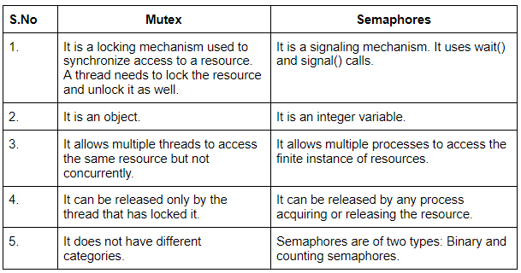
3.7 - LOCKS/MUTEXES AND SEMAPHORES
IGOR SYRYTSIN, CAOS, SW4 2024

Slide 34
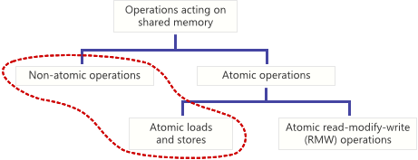

4 - ATOMIC VS. NON-ATOMIC OPERATIONS
Definition of atomic operations: complete in a single step relative to other threads, preventing "half-complete" states.
Importance of atomicity: enables lock-free programming, ensuring full values are written or read.
Data races and undefined behavior: consequences of non-atomic operations include torn reads/writes.
Rule of atomic operations: mandatory when two threads concurrently access a shared variable and at least one writes.
Compiler's role: atomicity is not assured in C/C++ unless specified; portable code must presume non-atomicity.
IGOR SYRYTSIN, CAOS, SW4 2024

Slide 35
4.1 - Atomic Operations: Hardware and Language Standards
Non-Atomic due to CPU instructions: Example of 64-bit variables on 32-bit systems.
Non-Atomic CPU instructions: Single CPU instruction may still result in non-atomic behavior on some processors.
C/C++ atomicity presumption: All operations considered non-atomic unless guaranteed by the compiler or hardware.
Atomic libraries in C++11 and Mintomic: Providing portably atomic loads/stores across platforms.
Practical implications: Use atomic library functions for shared memory operations to avoid concurrent access issues.
#include <mintomic/mintomic.h>
mint_atomic64_t sharedValue = { 0 };
void storeValue() {
mint_store_64_relaxed(&sharedValue, 0x100000002);
}
uint64_t loadValue() {
return mint_load_64_relaxed(&sharedValue);
}
IGOR SYRYTSIN, CAOS, SW4 2024

Slide 36
4.2 - Atomic Operations: Hardware and Language Standards
Relaxed atomic operations: Do not guarantee against instruction reordering but remain atomic.
Memory ordering with relaxed atomics: Possible reordering of operations without affecting atomicity.
Implementation in Mintomic and C++11: Inline assembly on x86; platform-specific implementation in Mintomic.
Memory ordering terms in C++11: memory_order_relaxed indicates minimal memory ordering constraints.
Best practices: Utilize atomic functions for concurrent memory manipulation for clarity and safety.
#include <mintomic/mintomic.h>
mint_atomic64_t sharedValue = { 0 };
void storeValue() {
mint_store_64_relaxed(&sharedValue, 0x100000002);
}
uint64_t loadValue() {
return mint_load_64_relaxed(&sharedValue);
}
IGOR SYRYTSIN, CAOS, SW4 2024

Slide 37

4.3 - THREAD-SAFE DATA STRUCTURES
A thread-safe data structure like a HashMap ensures that concurrent modifications by multiple threads do not lead to data corruption.
Hash functions distribute keys (like movie genres) into various buckets (values), minimizing collisions and allowing efficient data retrieval.
In a multi-threaded environment, thread-safety can be achieved using mechanisms like ConcurrentHashMap in Java, which handles synchronization internally.
When using thread-safe collections, operations like put, get, and remove are typically atomic and encapsulate any necessary locking.
It’s important to understand the performance implications of thread-safe structures as the internal locking mechanisms can introduce overhead.
Developers should ensure proper usage of these structures to avoid common pitfalls such as deadlocks or reduced performance due to excessive synchronization.
IGOR SYRYTSIN, CAOS, SW4 2024

Slide 38
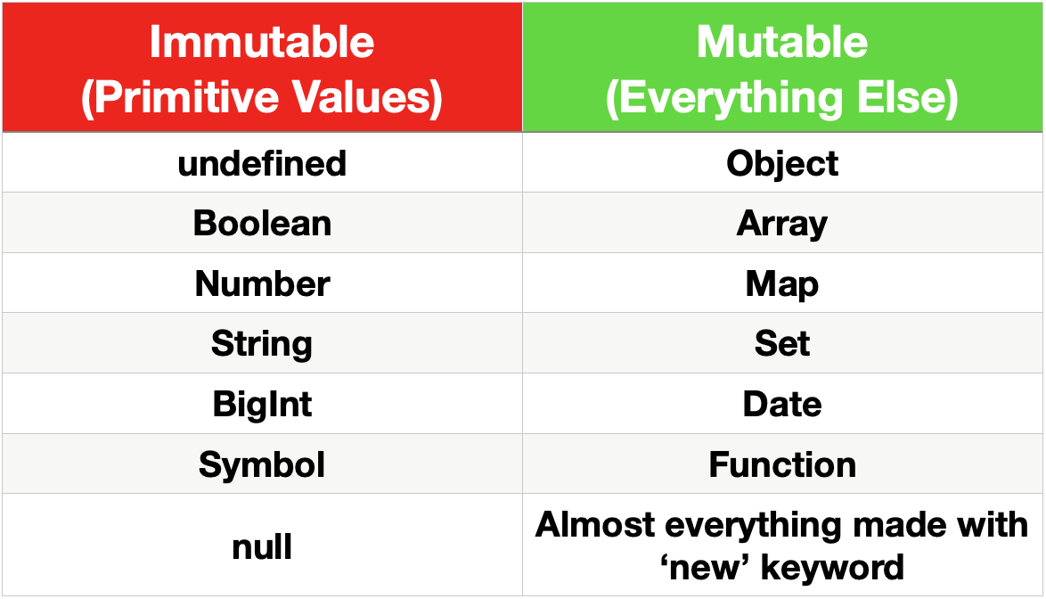
4.4 - IMMUTABLE OBJECTS AND THEIR BENEFITS
IGOR SYRYTSIN, CAOS, SW4 2024

Slide 39
4.5 - IMMUTABLE OBJECTS AND THEIR BENEFITS
Immutable objects, like primitive values, cannot be altered after creation, which leads to safer code by preventing accidental changes.
Examples of immutable values include undefined, Boolean, Number, String, BigInt, Symbol, and null, as they do not allow modification of their state.
The immutability of these primitives ensures that they can be passed around functions or threads without the risk of value changes, thus avoiding side effects.
Mutable objects, in contrast, such as Object, Array, Map, Set, Date, Function, and others created with the new keyword, can have their state changed after creation.
The use of immutable objects simplifies the understanding of the program flow, as their state remains constant throughout the execution.
Benefits include easier debugging, thread safety in concurrent programming, and avoiding complex state management issues that can arise with mutable objects.
IGOR SYRYTSIN, CAOS, SW4 2024

Slide 40
5 - Quick recap of key points from Themes 1-4
Introduction to Concurrency: Understanding the basics of concurrent execution in operating systems, and why it's crucial for multitasking and efficient resource use.
Threads and Processes: Distinguishing between these two fundamental concepts of concurrency, with threads being the basic unit of CPU utilization within a process.
Concurrency Challenges: Addressing common issues like race conditions, deadlocks, and starvation, all of which can disrupt synchronized operations if not properly managed.
Synchronization Mechanisms: Exploring tools like mutexes, semaphores, and locks which are designed to prevent concurrency problems by controlling access to resources.
Atomic Operations: Implementing indivisible operations that ensure data is accurately shared between threads, avoiding inconsistent states.
Thread-Safe Data Structures: Using structures like ConcurrentHashMap in Java that manage synchronization internally to prevent thread interference.
Immutable Objects: Leveraging objects that cannot be modified after creation, ensuring inherent thread safety without the need for external synchronization.
Locks vs. Semaphores: Understanding the difference between these synchronization tools; locks provide exclusive access, while semaphores limit the number of threads that can access a resource simultaneously.
Reentrant Locks: Allowing threads to acquire the same lock multiple times safely, preventing deadlocks within recursive calls.
Practical Applications: Highlighting the real-world uses of concurrency control in web servers, database systems, and real-time applications, showing how these concepts are critical in the design and functioning of modern software.
IGOR SYRYTSIN, CAOS, SW4 2024

